Slide 1
Business Intelligence(Mini Hackethon) IMDB Data Analysis Prof. Shilpa Sonawani
PC44 Palak Mallawat
PC46 Rashi Madnani
PC47 Dhanashree Lodhe

Slide 2
Data Scraping
Retrieving data from IMDB’s top rated titles
Implemented using Python’s Beautiful Soup
Beautiful Soup
Beautiful Soup is a Python package used to parse HTML pages mainly and extract data. The usage of this package was very simple and I hit the ground running with this easy to use package despite having no experience in web scraping
Procedure
IMDB Web Links were collected for all the genres(Action, Animation, Biography, Comedy, Crime, Drama, Fantasy, Horror, Mystery, Romance, Sci-fi, Thriller, and War were stored into different excel sheets. Using jupyter notebook various data were extracted and saved in the form of dataframe. Features like Ranking, Title, release year were extracted together and then split in python and stored in different columns. Features like votes was extracted by separating gross value. All of these features were then combined to form a single dataframe. This process was repeated for all genres and then later combined to further clean and preprocess using R.
Extracted Raw Data
The 32135 Movie titles extracted were parsed into different columns which were namely: Ranking, Movie Title, Release Year, Movie Duration, Primary Genre, Sub Genres (Non-Primary Genres), User Rating, User Votes.

Slide 3
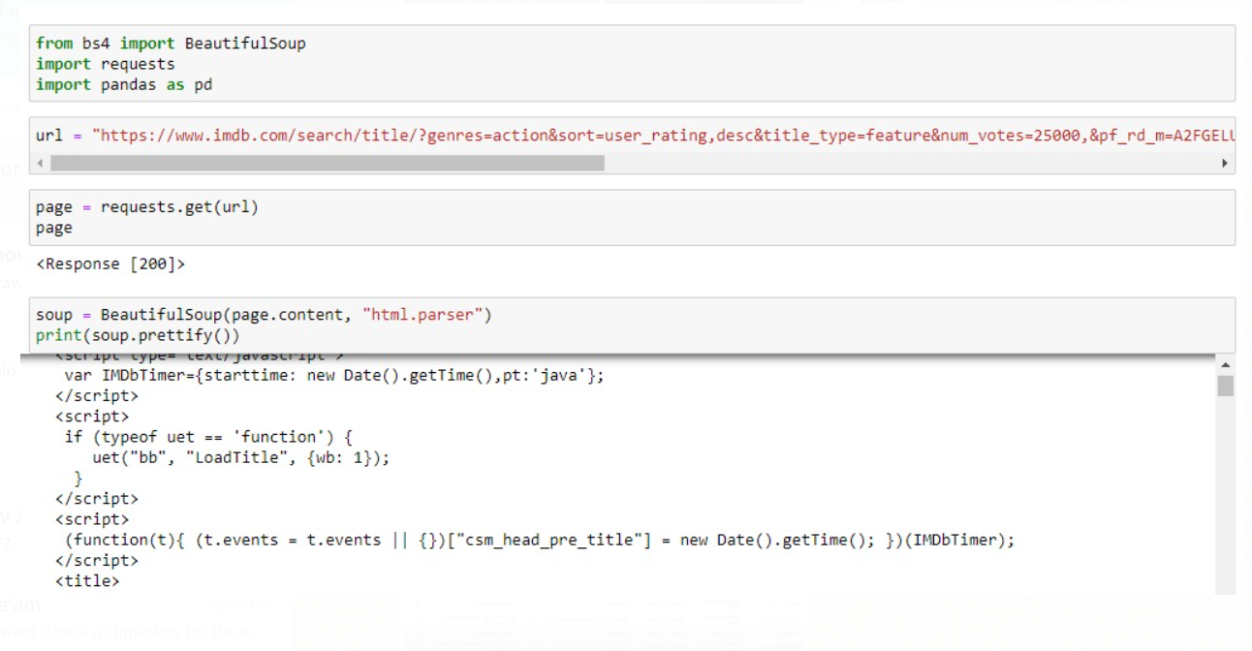

Slide 4
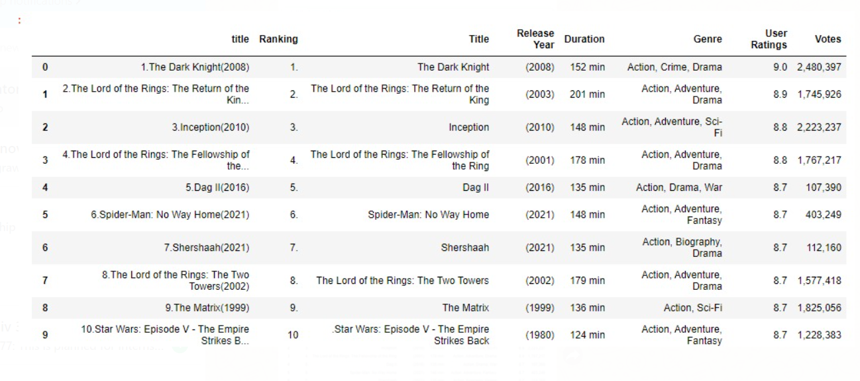

Slide 5
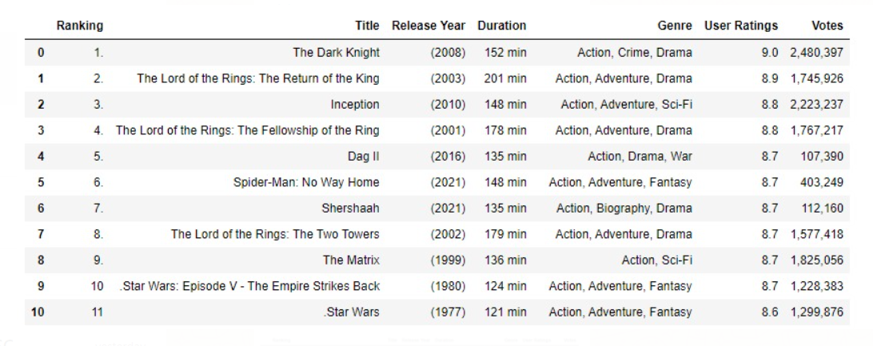

Slide 6
Data Cleaning & Preprocessing
Pre-processing data into a further usable format
Symbol removal
Integer columns such as Release Year contained unwanted symbols like ( , ), (-), I, V, X while Duration Column contained phrases like min. These all were replaced by whitespaces and then the column values were trimmed
Column splitting
Columns such as Sub Genres contained multiple columns inside them. These were split into multiple columns using delimiter as the basis of splitting.
Duplicate removal
Since all the movies scraped were top rated, so a lot of movies were duplicate in the main dataframe.
Column Removal
Almost all columns had minimal or no NA values except Sub Genre 3 . Sub Genre 3 had about 25% NA values and since the column isn’t very important, we removed it.

Slide 7

Data Visualization
Visualization was required to learn more about the data set and convey the results of the analytical questions we had regarding the IMDB dataset in a comprehensive method. used very easy to use and gave quality results.

Slide 8
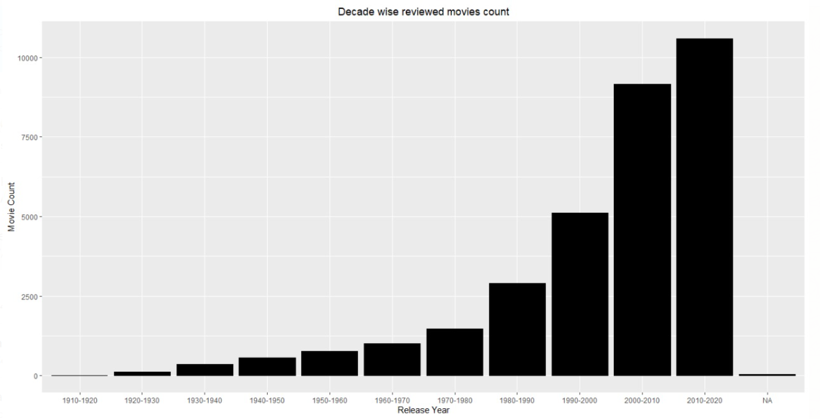

Slide 9
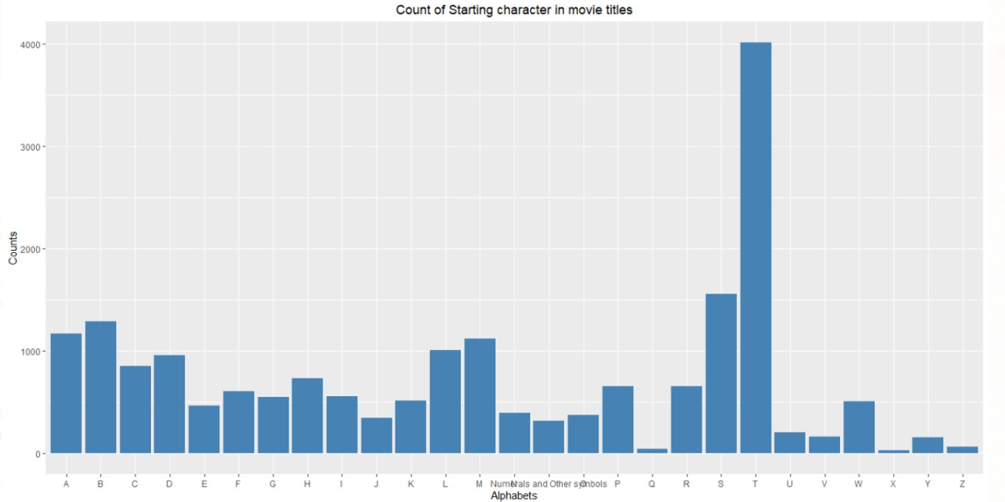

Slide 10
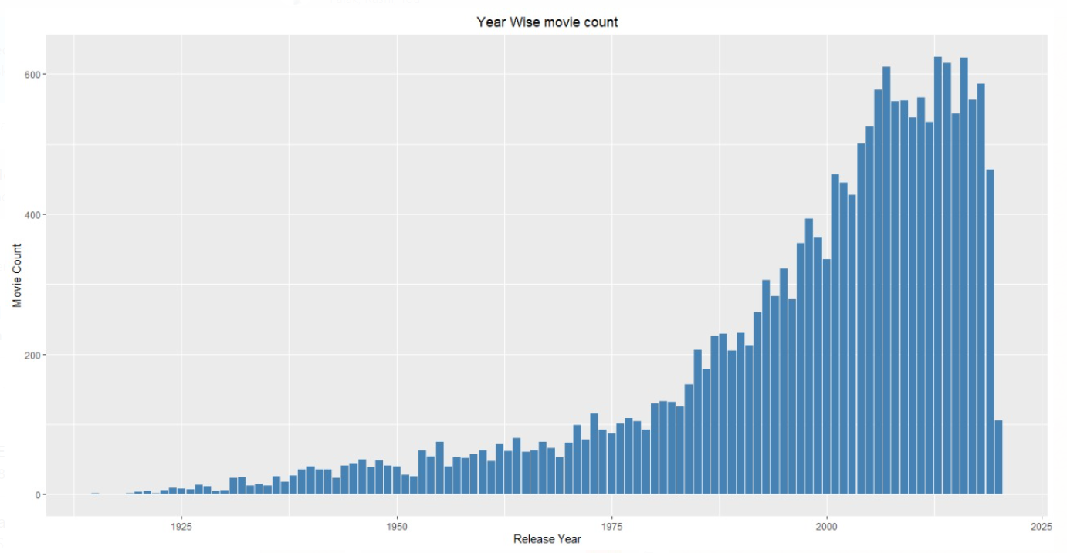

Slide 11
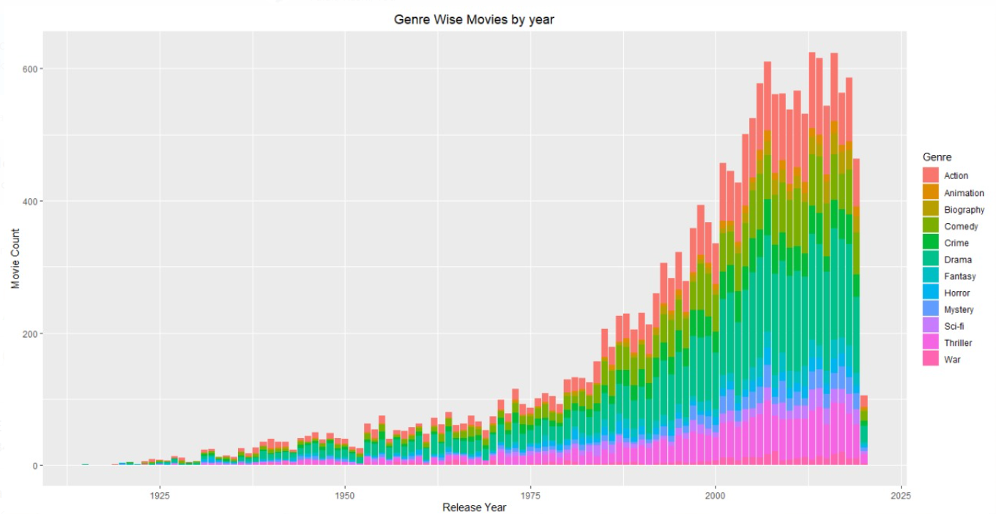

Slide 12
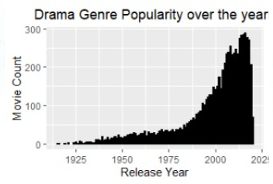
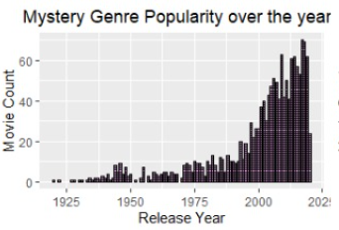
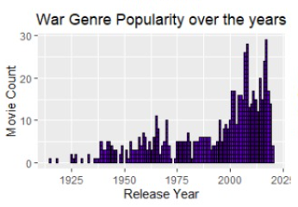
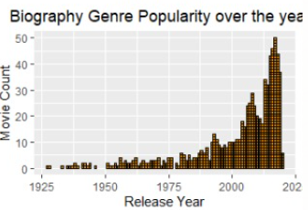

Slide 13
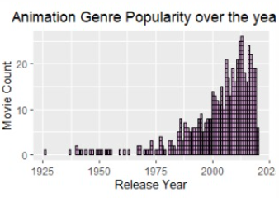
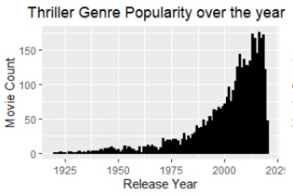
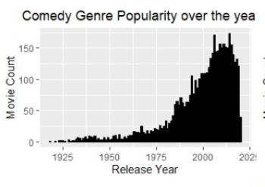
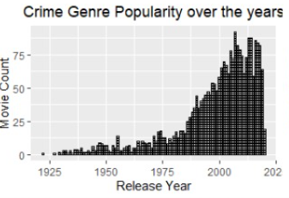

Slide 14
Predicting Movie IMDB Rating
KNN Regressor
kNN stands for k-Nearest Neighbors. It is a supervised learning algorithm. This means that we train it under supervision. We train it using the labeled data already available to us.
KNN regression is a non-parametric method that, in an intuitive manner, approximates the association between independent variables and the continuous outcome by averaging the observations in the same neighborhood.
We split the data into x train, y train, x test and y text
Our target variable is user rating
Our features are Ranking, release year, duration, genre, sub genre and votes
To train the model we pass the x train and y train and k=12 and then further test the model by predicting y test.

Slide 15
Predicting Movie IMDB Rating
Model Evaluation on Basis of Various Metrics
R2 Score
Coefficient of Determination. Means the % of variation of dependent variable which can be explained by independent variable. More the merrier.
Mean Squared Error
MSE measures the average of error squares i.e the average squared difference between the estimated values and true value. Less the better.
Mean Absolute Error
(MAE) is a measure of errors between paired observations expressing the same phenomenon. MAE takes the average of absolute errors for a group of predictions and observations as a measurement of the magnitude of errors for the entire group.

Slide 16
Predicting Movie IMDB Rating K-Nearest Neighbor
01
02
03
Mean Squared Error
R2 Score
Absolute Error
0.4301296
0.7906308
0.5805556

Slide 17
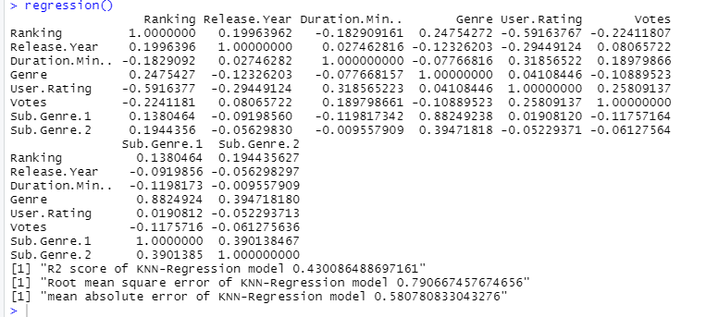
Results

Slide 18
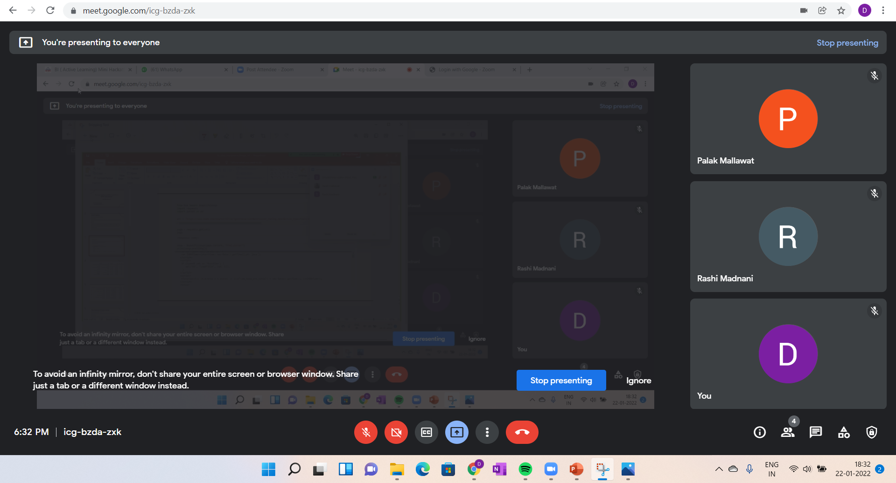
Meeting Screenshot

Slide 19
Thank You!

